Slide 1
Searching for Amorphous MgO Triple Junctions
2/08/16 Oliver Thomas

Slide 2
This week
Investigate different quenching rates of the temperature to see if I can get a “frozen” structure.
Simulate for a larger unit cell to see if multiple grains form.

Slide 3
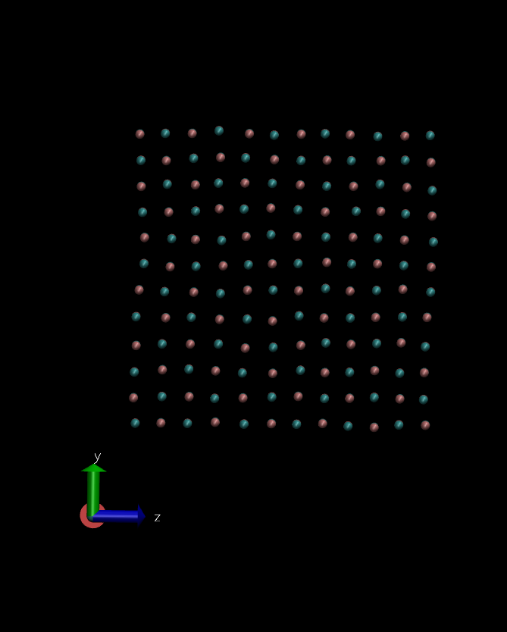
12x12x2 Unit cell, 144 columns
MC stats:
starting energy = -5925.6712 eV
final energy = -5906.7988
Disordered accepted MC moves = 792
Disordered total moves = 5000
Accepted MC moves = 412
Total moves = 23800
Ratio of accepted/Total = 1.73 %
Immediate quenching from 500eV to 0.026eV

Slide 4
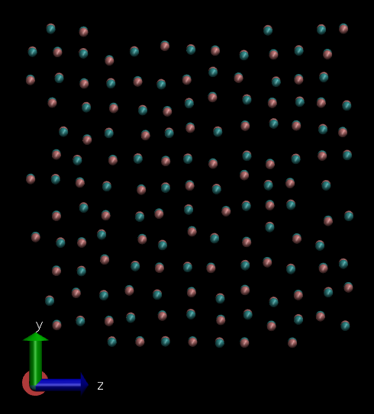
12x12x2 Unit cell, 144 columns

Slide 5
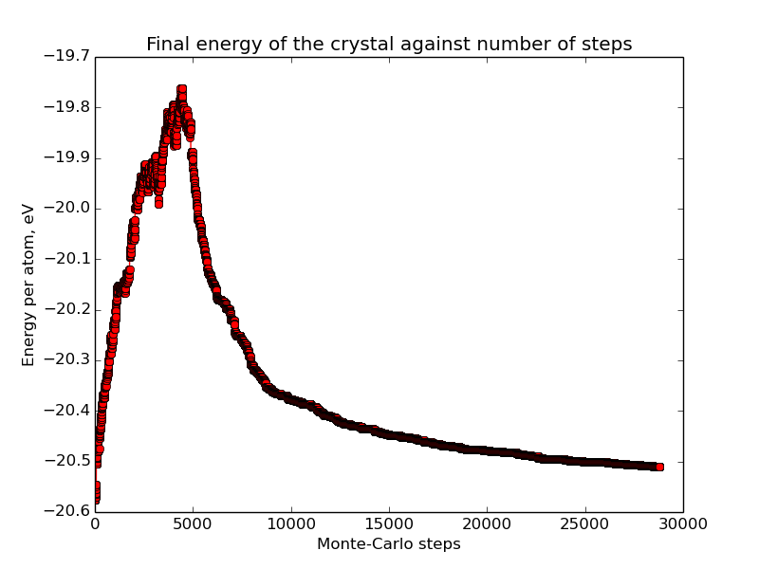
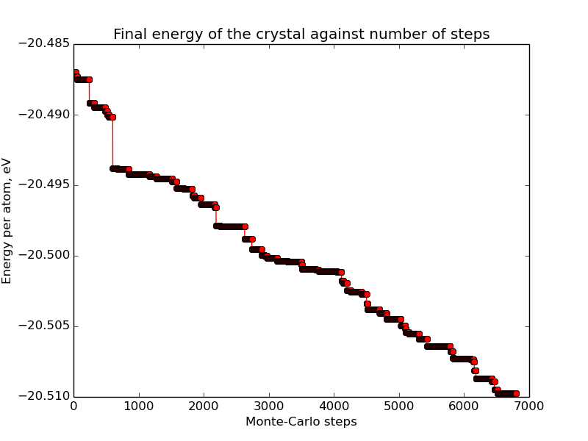
12x12x2 Unit cell, 144 columns
22000 to 28800 steps

Slide 6
New approach
Implimented varying move distance, 1.0A to 1.5A for disorder phase. 0.5A for quenching. Should help system freezing into a higher energy state/not returning to lowest energy state.
Haven't run yet due to the problems.

Slide 7
Problems
Atom overlap is the biggest problem.
Can't run in parallel, Infinite energy after moving a column with the set atom command when run on more than one processor when using mpirun -np x.

Slide 8
Atom overlap
When columns get too close the potential massively decreases e.g. -10^-4 to -10^-6.
Temporary fix by decreasing the temperature from 1000eV to 500eV.
For the test cell case (perfect crystal structure) used the geometry optimised potential as the lowest value, if a move produced a lower energy than this base, reject the move.
However this would only work for the test case as the lowest energy state is known, not valid for constrained case at grain boundaries.
Didn't work anyway clusters of overlap atoms formed.

Slide 9
Atom overlap
Tried setting the atoms to inlcude zero weighted bonds
Compute bond/local dist - bond lengths were ~e20
Tried setting the atoms to type sphere
Compute pair/local dist
Compute contact/atom – check if sphere is overlapping
Can't find a way of using compute values in the program can only output them and use them for post processing – no good .

